Slide 1
Design Concepts & ER Model
Notes:
1
The slides for this text are organized into several modules. Each lecture contains about enough material for a 1.25 hour class period. (The time estimate is very approximate--it will vary with the instructor, and lectures also differ in length; so use this as a rough guideline.) This covers Lectures 1 and 2 (of 7) in Module (5).
Module (1): Introduction (DBMS, Relational Model)
Module (2): Storage and File Organizations (Disks, Buffering, Indexes)
Module (3): Database Concepts (Relational Queries, DDL/ICs, Views and Security)
Module (4): Relational Implementation (Query Evaluation, Optimization)
Module (5): Database Design (ER Model, Normalization, Physical Design, Tuning)
Module (6): Transaction Processing (Concurrency Control, Recovery)
Module (7): Advanced Topics

Slide 2
A motivating Example
A company has a large collection (say, 500 GB) of data on employees, departments, products, sales, and so on.
This data is accessed concurrently by several employees.
Questions about the data must be answered quickly, changes made to the data by different users must be applied consistently, and access to certain parts of the data (e.g., salaries) must be restricted.

Slide 3
DBMS: Advantages
Data Independence
Efficient Data access
Data Integrity & Security
Concurrent Access/ Crash Recovery
Reduced Application Development time

Slide 4
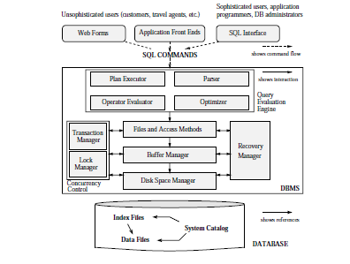
DBMS: Architecture

Slide 5
Data Model
A data model is a collection of high-level data description constructs that hide many
low-level storage details.
A DBMS allows a user to define the data to be stored in terms of a data model. Most database management systems are based on the relational data model.

Slide 6
Data Model
A semantic data model is a more abstract, high-level data model that makes it easier for a user to come up with a good initial description of the data in an enterprise.
These models contain a wide variety of constructs that help describe a real application scenario.
A DBMS is not intended to support all these constructs directly; it is typically built with just a few basic constructs, such as the relational model.

Slide 7
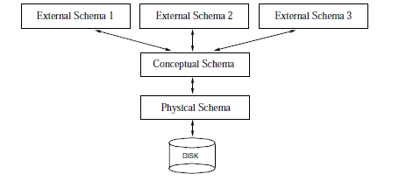
Levels of Abstraction

Slide 8
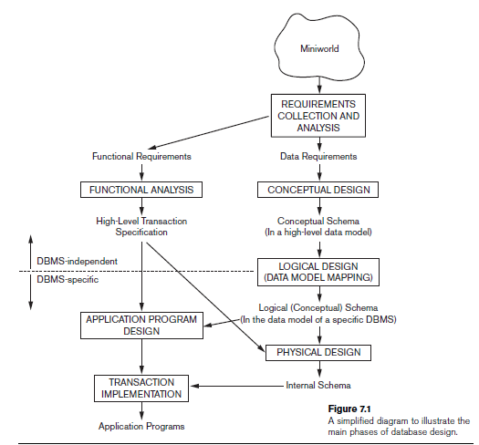
Pathway: A database Application Development
sankhayan@gmail.com

Slide 9
Overview of db design
Requirement analysis
  Data to be stored
  Applications to be built
  Operations (most frequent) subject to performance requirement
Conceptual db design
  Description of the data (including constraints)
  By high level model such as ER
Logical db design
  Choose DBMS to implement
  Convert conceptual db design into database schema
  Beyond ER design
Schema refinement (normalization)
Physical db design
  Analyze the workload
  Refine db design to meet performance criteria (focus on Indexing)
Security design

Slide 10
Relational Model
The central data description construct is a relation i.e. A collection of records.
A description of data in terms of a data model is called a schema.
A schema of a relation specifies its name, the participating fields and the type of each field.
Students(sid: string, name: string, login: string, age: integer, gpa: real)

Slide 11
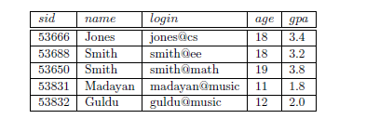
An Instance of a Relation

Slide 12

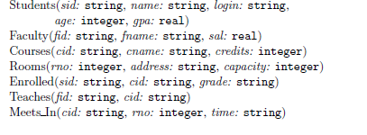
Logical Schema

Slide 13
Inside a Database
Tables
Relationship among tables
Operations (queries)

Slide 14
Conceptual design
Issues to consider: (ER Model is used at this stage.)
  What are the entities and relationships in the enterprise?
  What information about these entities and relationships should we store in the database (i.e., attributes)?
  What are the integrity constraints or business rules that hold?
Solution:
  A database `schema’ in the ER Model can be represented pictorially (ER diagrams).
  Can map an ER diagram into a relational schema.
Notes:
2

Slide 15
ER Model Basics
name
ssn
lot
Employees
Entity: Real-world object distinguishable from other objects. An entity is described (in DB) using a set of attributes.
Entity Set: A collection of similar entities. E.g., all employees.
  All entities in an entity set have the same set of attributes.
  Each entity set has a key.
  Each attribute has a domain.
What’s the key? How many keys one object can have?
Notes:
3
The slides for this text are organized into several modules. Each lecture contains about enough material for a 1.25 hour class period. (The time estimate is very approximate--it will vary with the instructor, and lectures also differ in length; so use this as a rough guideline.) This covers Lectures 1 and 2 (of 6) in Module (5).
Module (1): Introduction (DBMS, Relational Model)
Module (2): Storage and File Organizations (Disks, Buffering, Indexes)
Module (3): Database Concepts (Relational Queries, DDL/ICs, Views and Security)
Module (4): Relational Implementation (Query Evaluation, Optimization)
Module (5): Database Design (ER Model, Normalization, Physical Design, Tuning)
Module (6): Transaction Processing (Concurrency Control, Recovery)
Module (7): Advanced Topics

Slide 16
Key
A key is a minimal set of attributes whose values uniquely identify an entity in the set.
Candidate key.
Primary key.

Slide 17
Entity, Entity Set, Attribute, and Schema
ID or SSN
Name
UserID
Age
GPA
999-38-4431
John Smith
jsmith
21
3.68
999-28-3341
Miki Jordan
mjordan
28
3.45
331-43-4567
David Kim
dkim
25
4.00
535-34-5678
Paul Lee
plee
26
3.89

Slide 18
ER Model Basics (Contd.)
since
name
dname
ssn
lot
did
budget
Employees
Works_In
Departments
Relationship Set
Relationship: Association among 2 or more entities. E.g., Sam works in the Accounting Department.
Relationship Set: Collection of similar relationships.
  An n-ary relationship set R relates n entity sets E1 ... En; each relationship in R involves entities e1 E1, ..., en En
    Same entity set could participate in different relationship sets, or in different “roles” in same set.
Notes:
4

Slide 19
Entity vs. Entity Set
Object --- Student
John Smith
(999-21-3415, jsmith@, John Smith, 18, 3.5)
Students in ITCS3160
999-21-3415, jsmith@, John Smith, 18, 3.5
999-31-2356, jzhang@, Jie Zhang, 20, 3.0
999-32-1234, ajain@, Anil Jain, 21, 3.8

Slide 20
Example of Keys
Primary key
Candidate key
999-21-3415, jsmith@, John Smith, 18, 3.5
999-31-2356, jzhang@, Jie Zhang, 20, 3.0
999-32-1234, ajain@, Anil Jain, 21, 3.8

Slide 21
Relationship vs. Relationship Set
John Smith
(999-21-3415, jsmith@, John Smith, 18, 3.5)
Relationship
ITCS3160
(3160, ITCS, DBMS, J. Fan, 3, Kenn. 236)

Slide 22
Relationship vs. Relationship Set
999-21-3415, jsmith@, John Smith, 18, 3.5
Students
999-31-2356, jzhang@, Jie Zhang, 20, 3.0
999-32-1234, ajain@, Anil Jain, 21, 3.8
Relationship set(“Enrolled in”)
3160, ITCS, DBMS, J. Fan, 3, Kenn. 236
Courses
6157, ITCS, Visual DB, J. Fan, 3, Kenn. 236

Slide 23
Relationship vs. Relationship Set
Name
Login
Age
Id
Name
Credit
room
Id
GPA
Students
Courses
Enrolled_In
Descriptive attribute
Grade

Slide 24
Example 1
Build an ER Diagram for the following information:
  Students
    Have an Id, Name, Login, Age, GPA
  Courses
    Have an Id, Name, Credit Hours
  Students enroll in courses
    Receive a grade
Notes:
2

Slide 25
Example 1 Answer
Name
Login
Age
Id
Name
Credit
Id
GPA
Students
Courses
Enrolled_In
Grade
Notes:
2

Slide 26
Example 2
Build an ER Diagram for the following information:
  Patients
    Name, Address, Phone #, Age
  Drugs
    Name, Manufacturer , Expiration Date
  Patients are prescribed drugs
    Dosage, # Days
Notes:
2

Slide 27
Example 2 Answer
Name
Addr
Phone
Name
Manuf
Exp
Age
Patients
Drug
Prescribed
Dosage
#days
Notes:
2

Slide 28
Constraints
Key constraints
Participation constraints

Slide 29
Potential Relationship Types
1-to-1
1-to Many
Many-to-1
Many-to-Many

Slide 30
Potential Relationship Types
?
?
Students
IN
CS Dept
Mary studies in the CS Dept.
Tom studies in the CS Dept.
Jack studies in the CS Dept.
…
The CS Dept has lots of students.
No student in the CS Dept works in other else Dept at the same time.

Slide 31
Potential Relationship Types
?
?
Students
take
Courses
Mary is taking the ITCS3160,ITCS2212.
Tom is taking the ITCS3160, ITCS2214.
Jack is taking the ITCS1102, ITCS2214.
…
61 students are taking ITCS3160.
120 students are taking ITCS2214.

Slide 32
Key Constraints
why "work-in" is not "key constraint"?
Consider Works_In:
An employee can work
in many departments;
a dept can have many employees.
since
name
dname
ssn
lot
did
budget
Employees
Works_In
Departments

Slide 33
Key Constraints
Consider Works_In:
An employee can work
in at most one department;
a dept can have many employees.
since
name
dname
ssn
lot
did
budget
Employees
Works_In
Departments

Slide 34
Key Constraints
why "manage" should be "key constraint"?
At most one!!!
In contrast, each dept has at most one manager, according to the key constraint on Manages.
since
name
dname
ssn
lot
did
budget
Employees
Manages
Departments
Key Constraint
(time constraint)
Notes:
6

Slide 35
Participation Constraints
Does every department have a manager?
  If so, this is a participation constraint: the participation of Departments in Manages is said to be total (vs. partial).
    Every did value in Departments table must appear in a row of the Manages table (with a non-null ssn value!)
since
since
name
name
dname
dname
ssn
did
did
budget
lot
budget
Employees
Manages
Total w/key
constraint
Departments
Partial
Total
Works_In
Total
since
Notes:
8

Slide 36
What are the policies behind this ER model?
since
since
name
name
dname
dname
ssn
did
did
budget
lot
budget
Employees
Manages
Total w/key
constraint
Departments
Total
Total
Works_In
Total
since

Slide 37
since
name
dname
ssn
lot
did
budget
Employees
Manages
Departments
Any Difference?
Works_In
since
since
name
name
dname
dname
ssn
did
did
budget
lot
budget
Employees
Manages
Total w/key
constraint
Departments
Partial
Total
Works_In
Total
since
Notes:
8

Slide 38
Weak Entities vs. Owner Entities
A weak entity can be identified uniquely only by considering the primary key of another (owner) entity.
  Owner entity set and weak entity set must participate in a one-to-many relationship set (1 owner, many weak entities).
  Weak entity set must have total participation in this identifying relationship set.
name
ssn
lot
cost
pname
age
Primary Key
for weak entity
Employees
Policy
Dependents
Identifying Relationship
Weak Entity
Notes:
10

Slide 39
Ternary Relationship
name
dname
ssn
lot
did
budget
Employees
Works_In3
Departments
from
Duration
to
Why?
since
name
dname
ssn
lot
did
budget
Employees
Works_In
Departments

Slide 40
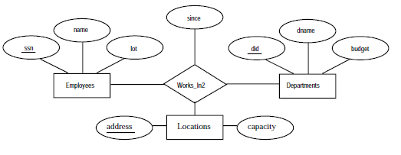
Ternary Relation

Slide 41
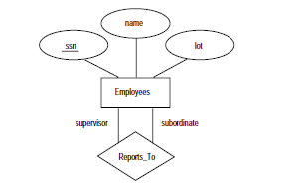
Recursive Relation

Slide 42
ISA (`is a’) Hierarchies
name
ssn
lot
Employees
As in C++, or other PLs, attributes are inherited.
hourly_wages
hours_worked
ISA
contractid
If we declare A ISA B, every A entity is also considered to be a B entity.
Hourly_Emps
Contract_Emps
Overlap constraints: Can Joe be an Hourly_Emps as well as a Contract_Emps entity? (Allowed/disallowed)
Covering constraints: Does every Employees entity also have to be an Hourly_Emps or a Contract_Emps entity? (Yes/no)
Reasons for using ISA:
  To add descriptive attributes specific to a subclass.
  To identify entitities that participate in a relationship.
Notes:
12

Slide 43
Aggregation
name
ssn
lot
Employees
Used when we have to model a relationship involving (entitity sets and) a relationship set.
  Aggregation allows us to treat a relationship set as an entity set for purposes of participation in (other) relationships.
  Monitors mapped to table like any other relationship set.
Monitors
until
Aggregation
started_on
dname
pid
pbudget
did
budget
Projects
Sponsors
Departments
Notes:
2

Slide 44
Real Database Design
Build an ER Diagram for the following information:
  Walmart Stores
    Store Id, Address, Phone #
  Products
    Product Id, Description, Price
  Manufacturers
    Name, Address, Phone #
  Walmart Stores carry products
    Amount in store
  Manufacturers make products
    Amount in factory/warehouses
Notes:
2

Slide 45
Conceptual Design Using the ER Model
Design choices:
  Should a concept be modeled as an entity or an attribute?
  Should a concept be modeled as an entity or a relationship?
  Identifying relationships: Binary or Ternary? Aggregation?
  Always follow the requirements.
Notes:
3

Slide 46
Entity vs. Attribute
Should address be an attribute of Employees or an entity (connected to Employees by a relationship)?
Depends upon the use we want to make of address information, and the semantics of the data:
    If we have several addresses per employee, address must be an entity (since attributes cannot be set-valued).
    If the structure (city, street, etc.) is important, e.g., we want to retrieve employees in a given city, address must be modeled as an entity (since attribute values are atomic).

Slide 47
Entity vs. Attribute (Contd.)
from
to
Works_In2 does not allow an employee to work in a department for two or more periods.
Similar to the problem of wanting to record several addresses for an employee: we want to record several values of the descriptive attributes for each instance of this relationship.
name
dname
ssn
lot
did
budget
Employees
Works_In2
Departments
name
dname
ssn
lot
did
budget
Employees
Works_In3
Departments
from
Duration
to
Notes:
5

Slide 48
Entity vs. Relationship
First ER diagram OK if a manager gets a separate discretionary budget for each dept.
  Redundancy of dbudget, which is stored for each dept managed by the manager.
  Misleading: suggests dbudget tied to managed dept.
What if a manager gets a discretionary budget that covers all managed depts?
since
dbudget
name
dname
ssn
lot
did
budget
Employees
Manages2
Departments
name
dname
ssn
lot
did
budget
Employees
Manages3
Departments
since
apptnum
Mgr_Appts
dbudget
Notes:
6

Slide 49

Requirements
An employee can own several policies, each policy can be owned by several employees, and each dependent can be covered by several policies.
Additional requirements:
A policy cannot be owned jointly by two or more employees.
Every policy must be owned by some employee.

Slide 50
Binary vs. Ternary Relationships
*
name
ssn
lot
pname
age
If each policy is owned by just 1 employee:
  Key constraint on Policies would mean policy can only cover 1 dependent!
Employees
Covers
Dependents
Bad design
Policies
policyid
cost
name
pname
age
ssn
lot
Dependents
Employees
Purchaser
Beneficiary
Better design
Policies
policyid
cost
Notes:
7

Slide 51
Binary vs. Ternary Relationships (Contd.)
Previous example illustrated a case when binary relationships were better than one ternary relationship.
An example in the other direction: a ternary relation Contracts relates entity set Parts, Departments and Suppliers, and has descriptive attributes qty. No combination of binary relationships is an adequate substitute:
  S can supply P, D needs P, and D deals-with S does not imply that D has agreed to buy P from S.
  How do we record qty?
Notes:
8

Slide 52
Summary of Conceptual Design
Conceptual design follows requirements analysis,
  Yields a high-level description of data to be stored
ER model popular for conceptual design
  Constructs are expressive, close to the way people think about their applications.
Basic constructs: entities, relationships, and attributes (of entities and relationships).
Some additional constructs: weak entities, ISA hierarchies, and aggregation.
Note: There are many variations on ER model.
Notes:
11

Slide 53
Summary of ER (Contd.)
Several kinds of integrity constraints can be expressed in the ER model: key constraints, participation constraints, and overlap/covering constraints for ISA hierarchies. Some foreign key constraints are also implicit in the definition of a relationship set.
  Some constraints (notably, functional dependencies) cannot be expressed in the ER model.
  Constraints play an important role in determining the best database design for an enterprise.
Notes:
12

Slide 54
Summary of ER (Contd.)
ER design is subjective. There are often many ways to model a given scenario! Analyzing alternatives can be tricky, especially for a large enterprise. Common choices include:
  Entity vs. attribute, entity vs. relationship, binary or n-ary relationship, whether or not to use ISA hierarchies, and whether or not to use aggregation.
Ensuring good database design: resulting relational schema should be analyzed and refined further. FD information and normalization techniques are especially useful.
Notes:
13

Slide 55
Problem
Draw an ER diagram for the following application from the manufacturing industry:
1. Each supplier has a unique name.
2. More than one supplier can be located in the same city.
3. Each part has a unique part number.
4. Each part has a colour.
5. A supplier can supply more than one part.
6. A part can be supplied by more than one supplier.
7. A supplier can supply a fixed quantity of each part.

Slide 56
Problem
Notown Records has decided to store information about musicians who perform on its albums (as well as other company data) in a database. The company has wisely chosen to hire you as a database designer (at your usual consulting fee of $2,500/day).
Each musician that records at Notown has an SSN, a name, an address, and a phone number. Poorly paid musicians often share the same address, and no address has more than one phone.
Each instrument that is used in songs recorded at Notown has a name (e.g., guitar, synthesizer, flute) and a musical key (e.g., C, B-flat, E-flat).
Each album that is recorded on the Notown label has a title, a copyright date, a format (e.g., CD or MC), and an album identifier.
Each song recorded at Notown has a title and an author.
Each musician may play several instruments, and a given instrument may be played by several musicians.
Each album has a number of songs on it, but no song may appear on more than one album.
Each song is performed by one or more musicians, and a musician may perform a number of songs.
Each album has exactly one musician who acts as its producer. A musician may produce several albums, of course.

Slide 57
